Slide 1

PRESENTATION ON POWER CONTROL
Presented by :
Name: Arashdeep Singh
Entry No : 22MMCO02
Department: School of Electronics and communication Engineering

Slide 2
AGENDA
Introduction​
Application of WSNs
​Energy Management in WSNs
Energy Efficient Routing
​

Slide 3
Introduction
Wireless sensor networks to adjust energy consumption under different network conditions. This is a crucial goal, given the constraints under which sensor communications operate.
Doing same amount of work without any wastage of energy.

Slide 4
What is wsn
Wireless sensor network is a collection of large number of small nodes which as routers also.
These sensors are utilized to gather the data from the environment and transfer it to the base station.

Slide 5








Application of wsns
Environmental monitoring
Military related application
transportation
entertainment
1
2
3
4
Medical and health
security
Smart world
Industrial control
6
7
8
5

Slide 6
Energy managemt in wsn
Nodes carry limited power source which is non-rechargeable and non-replaceable which makes energy consumption as significant issue.

Slide 7
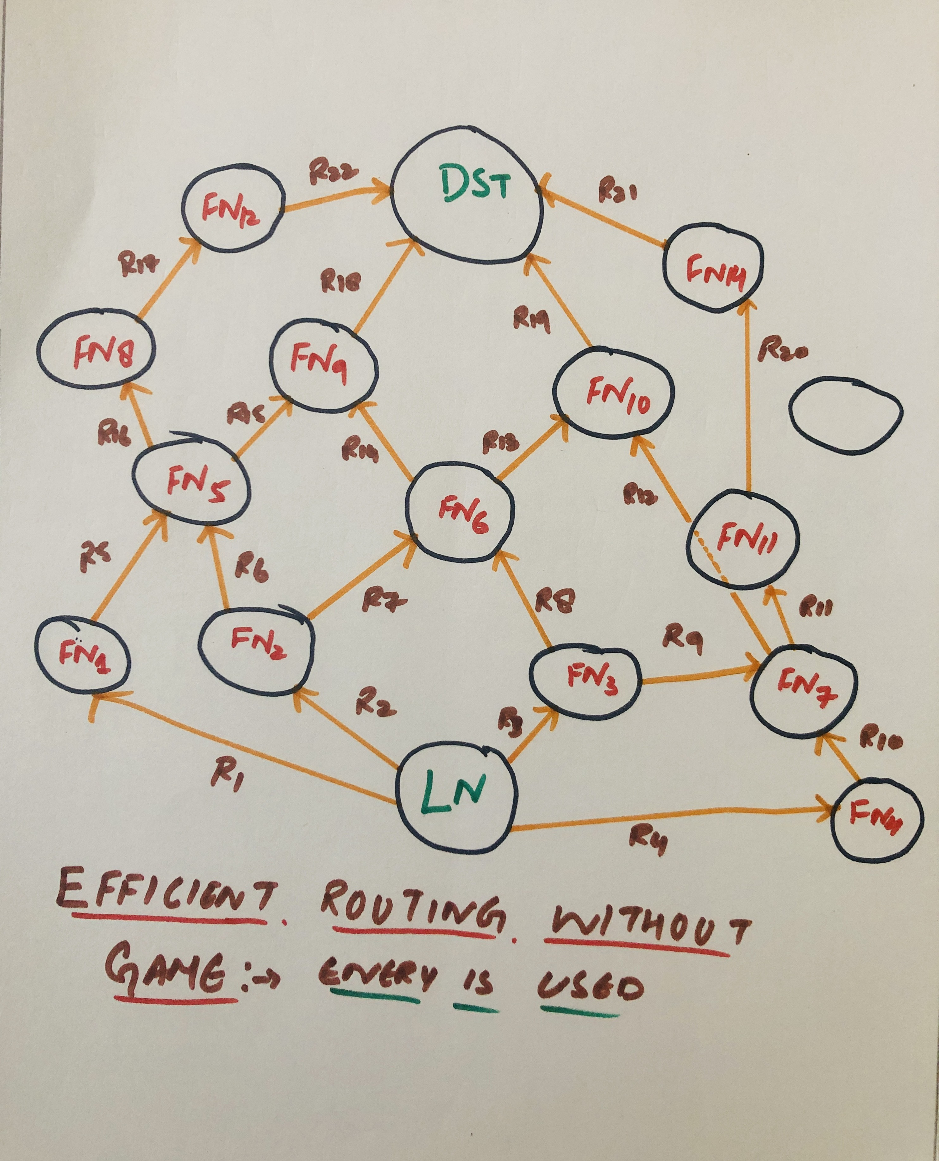
Energy efficient routing
Pre-defined:-

Slide 8
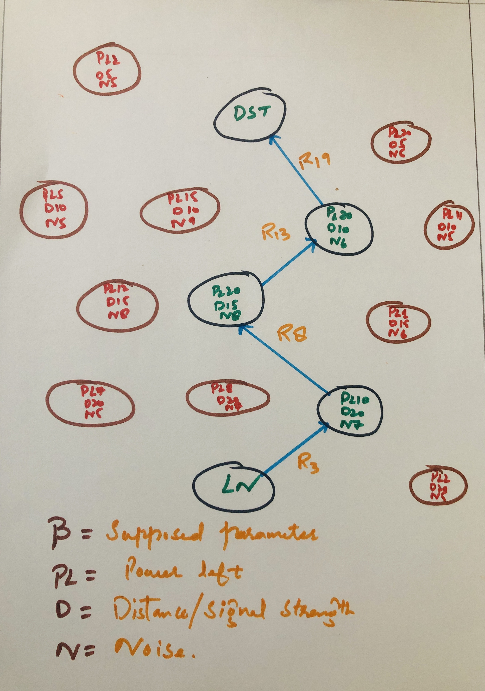
In utility function
Nodes that are not currently needed for ensuring connectivity can go to sleep and save energy.

Slide 9




THANK YOU
Arashdeep Singh (22mmc002)
ad.sng420@gmail.com
github.com/Arashdeepsng
@ad_sng

